Slide 1
Presentation brief for MCT’s
Title of presentation | Create a Stream Processing Solution with Event Hubs and Azure Databricks
Presentation\Lab length | Presentation: 10 - 20 minutes Lab: 50 – 60 minutes
Audience | Data Engineers, Data Scientists, Data Professionals, Data Architects, BI Professionals, Developers
Purpose | Understand the key features and uses of Structured Streaming Stream data from a file and write it out to a distributed file system Use sliding windows to aggregate over chunks of data rather than all data Apply watermarking to throw away stale old data that you do not have space to keep Connect to Event Hubs read and write streams
(think) Student key takeaways | The student should understand the key features and use-cases of Structured Streaming The student should comprehend data streaming from a file and write it out to a distributed file system The student should be able to understand windowing functions and watermarking The student should comprehend the connection to Event Hubs to read and write streams
(feel) Student desired mindset | The student may feel confusion about the connection between the different services for streaming The student may feel confusion around the use of a distributed file system The student may not be familiar with window aggregations and watermarking The student may confuse the interaction with Event Hubs to read and write streams
(do) Student outcomes | The student should be able to articulate a one sentence description of the key features of Structured Streaming The student should be able to stream data from a file and write it out to a distributed file system The student should be able to understand and implement window aggregations and watermarking The student should be able to connect to an Event Hub to read and write streams
More information | For MCT course feedback, visit the Microsoft Official Courseware forum
Notes:
Instructor notes and guidance
This slide is for MCT use only, outlining the aims and objectives of this module.

Slide 2
DP-203T00: Create a Stream Processing Solution with Event Hubs and Azure Databricks
Notes:
Instructor notes and guidance
Introduce to the students that this module explores a Stream Processing Solution with Event Hubs and Azure Databricks. At this stage they are building on the streaming technologies from Module 14, introducing Azure Databricks for structured streaming and Azure Event Hubs.
Students will first understand the concepts of Structured streaming. Then, students will be taught how to stream data from a file, in order to write that file into a distributed filesystem with Azure Databricks, by connecting to Event hubs to read and write the streams. They will be introduced to a notebook environment in Azure Databricks where they will be taught transformations such as window aggregations, and watermarking.
In the lab, we take to opportunity to explore how to ingest and process streaming data at scale with Event Hubs and Spark Structured Streaming in Azure Databricks. The student will learn the key features and uses of Structured Streaming. They will implement sliding windows to aggregate over chunks of data and apply watermarking to remove stale data. Finally, they will connect to Event Hubs to read and write streams.

Slide 3

Agenda
Lesson 01 – Understand the key features and uses of Structured Streaming
Lesson 02 – Stream data from a file and write it out to a distributed file system and connect to Event Hubs to read and write streams
Lesson 03 – Use sliding windows to aggregate over chunks of data rather than all data
Lesson 04 – Apply watermarking
Notes:
Instructor notes and guidance
This space has been left deliberately blank.

Slide 4
Lesson 01: Understand the key features and uses of Structured Streaming
Notes:
Instructor notes
This space has been left deliberately blank

Slide 5
Understand the key features and uses of Structured Streaming
Fast:
Processes millions of data in a matter of seconds.
Scalable:
Enables you to auto-scale
Fault-tolerant:
Structured Streaming automatically checkpoints the state data to fault-tolerant storage
Integration with other Cloud Services:
Can integrate with a variety of Azure data platform services such as Azure Event Hubs
Notes:
Talking points
With structured streaming using Apache Spark in Azure Databricks, you can process millions of data in a matter of seconds. Structured Streaming is a scalable and fault-tolerant stream processing engine built on the Spark SQL engine.
Structured Streaming automatically checkpoints the state data to fault-tolerant storage (for example, DBFS, Azure Blob storage).
Using Azure Event Hubs that can receive large amounts of data from multiple sources, we will stream and ingest the prepared data to Azure Data Lake or Azure Blob storage.
Azure Event Hubs can be integrated with Spark Structured Streaming, in Azure Databricks, to perform processing of messages in near real time.
You can query and analyze the processed data as it comes by using a Structured Streaming query and Spark SQL within the notebook environment of Azure Databricks.
Instructor notes and guidance
This slide focusses on the understanding of key features and uses of Structured Streaming with Apache Spark, using Azure Databricks and Azure Event Hubs.
Call out to the students, that in the lab for this module, they will experience working with Azure Databricks and how it works with structured streaming as well as Azure Event Hubs.
Recommended reading for this slide
Describe Azure Databricks structured streaming - Learn | Microsoft Docs

Slide 6
Lesson 02: Stream data from a file and write it out to a distributed file system and connect to Event Hubs to read and write streams
Notes:
Instructor notes
This space has been left deliberately blank

Slide 7
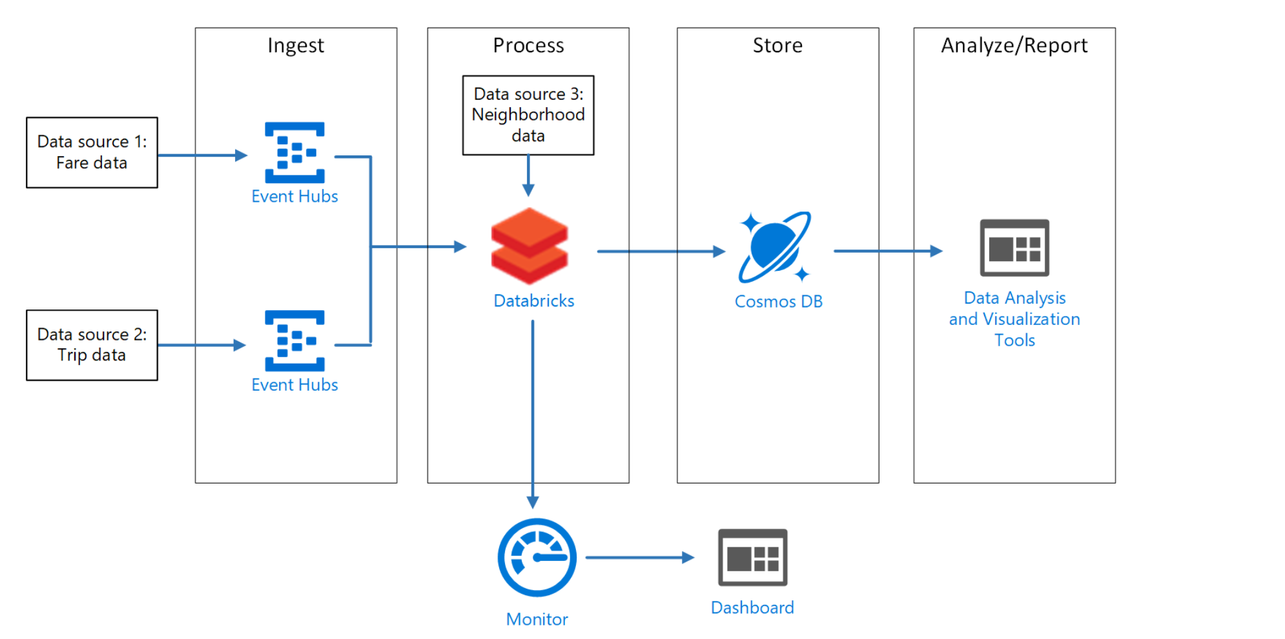
Stream data from a file and write it out to a distributed file system and connect to Event Hubs to read and write streams
Notes:
Talking points
In the architecture you find a complete solution for structured streaming using Azure Databricks, Azure Event Hubs, Cosmos DB and Data Visualization tools. In order to read a stream within a notebook in Azure Databricks, you can use the method SparkSession.readStream. This returns a DataStreamReader used to configure the stream.
There are a number of key points to the configuration of a DataStreamReader:
The schema
Every streaming DataFrame must have a schema - the definition of column names and data types. Some sources such as Pub/Sub sources like Kafka and Event Hubs define the schema for you, which is the case for the architecture shown in the slide. For file-based streaming sources, the schema must be user-defined.
Therefore, you need to understand the type of stream, and configurations specific to the type of stream i.e.:
The type of stream:
Files,
Kafka
TCP/IP
Configuration specific to the type of stream
For files, the file type, the path to the files, max files, etc...
For TCP/IP the server's address, port number, etc...
For Kafka the server's address, port, topics, partitions, etc...
In the architecture it’s shown that files are ingested in Azure Event hubs and write a stream to your event hub. Within a notebook of Azure Databricks the stream is read from your event hub, where transformations are made such as window aggregates. The results in this example are stored in Cosmos DB for further analysis where the output of the Analysis is visualized in for example Power BI.
Instructor notes and guidance
Only provide the information in relation to Azure Event Hubs and Azure Databricks, but call out that this could be an architecture for a complete structured streaming solution. It is not necessary to go in depth of storing data in Cosmos DB or visualizing in Power BI. This slide focusses mainly on Event hubs and Azure Databricks in relation to structured streaming.
Recommended reading for this slide
Process streaming data with Azure Databricks structured streaming - Learn | Microsoft Docs

Slide 8
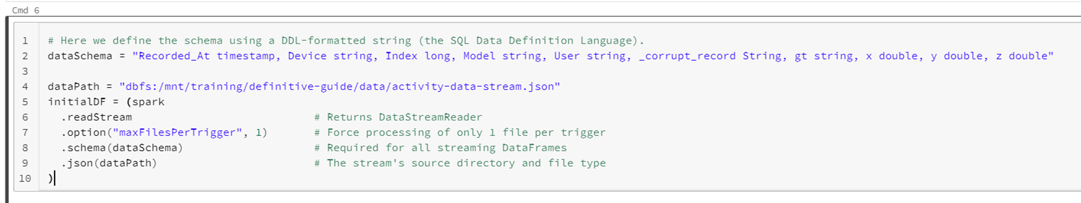
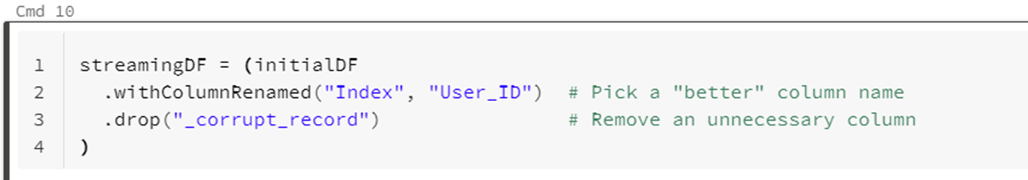
Configuring a file stream
Notes:
Talking points
In our example in the slide, we will be consuming files written continuously to a pre-defined directory. To control how much data is pulled into Spark at once, we can specify the option maxFilesPerTrigger. In our example below, we will be reading in only one file for every trigger interval:
.option("maxFilesPerTrigger", 1). Both the location and file type are specified with the following call, which itself returns a DataFrame:
.json(dataPath)
And with the initial DataFrame, we can apply some transformations.
Instructor notes and guidance
You can either read through the code on the slide, or better still, run through a working example in a Databricks workspace
Recommended reading for this slide
Process streaming data with Azure Databricks structured streaming - Learn | Microsoft Docs

Slide 9
Lesson 03: Use sliding windows to aggregate over chunks of data rather than all data
Notes:
Instructor notes
This space has been left deliberately blank

Slide 10
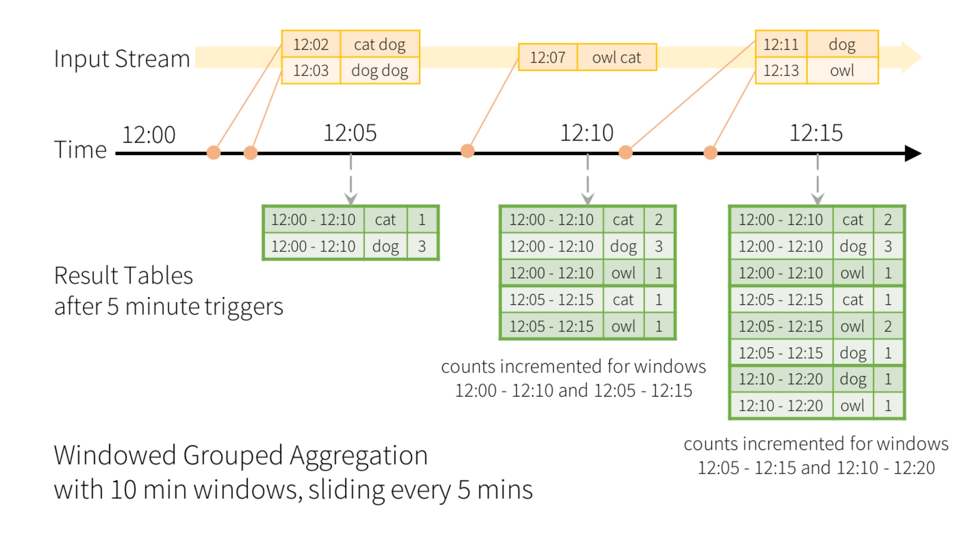
Use sliding windows to aggregate over chunks of data rather than all data
Notes:
Talking points
When you want to perform aggregations over a stream’s entire dataset, you might encounter some problems. Since incoming streams have a definitive start, conceptually there is no end to the flow of data, as data keeps coming in.
Because there is no "end" to a stream, the size of the dataset grows in perpetuity. In order to prevent your Azure Databricks cluster to run out of resources, when aggregating of the entire in perpetuity dataset, you can group data by windows of time. For example, every 5 minutes or every hour. This is referred to as windowing.
The diagram shows an example of a sliding window.
The windows overlap and a single event may be aggregated into multiple windows.
If we were using a static DataFrame to produce an aggregate count, we could use groupBy() and count().
Instead, we accumulate counts within a sliding window, answering questions like "How many records are we getting every second?"
Instructor notes and guidance
It is imperative for students to understand the sliding window concept, in order to aggregate data over chunks versus the entire dataset.
This is especially important when you continuously stream data. Also, note that the students will perform this operation in the lab, in a notebook within Azure Databricks.
Recommended reading for this slide
Process streaming data with Azure Databricks structured streaming - Learn | Microsoft Docs

Slide 11
Lesson 04: Apply watermarking
Notes:
Instructor notes
This space has been left deliberately blank

Slide 12
Apply watermarking
Prevent Data Build Up
Over time, aggregated data will build up in the driver
Prevents Long time running Jobs
Building up an unbounded set of windows, causing hit of resource limits
Notes:
Talking points
In the previous slide, we used and talked about a sliding window and how that could prevent running out of resources in a Azure Databricks Cluster.
However, in the scenario when you have many windows, you might encounter some other problems that need to be dealt with.
Since every window has to be separately persisted and maintained, over time, this aggregated data will build up in the driver nodes within Azure Databricks.
The end result being a massive slowdown if not an Out Of Memory (OOM) Error.
Therefore, we need to come up with a solution to prevent this slowdown or error.
One simple solution is to increase the size of our window (say, to 2 hours).
That way, we're generating fewer windows.
But if the job runs for a long time, we're still building up an unbounded set of windows.
Eventually, we could hit resource limits.
A better solution to the problem is to define a cut-off.
A point after which Structured Streaming will commit windowed data to sink, or throw it away if the sink is a console or memory as display() mimics.
That's what watermarking allows us to do.
Instructor notes and guidance
Explain the benefits of using watermarking in relation to windowing.
Feel free to go back to the previous slide where windowing is explained.
In the lab, students will run a notebook in Azure Databricks that explains and shows code of how to implement watermarking.
Recommended reading for this slide
Process streaming data with Azure Databricks structured streaming - Learn | Microsoft Docs

Slide 13
Review questions
Q01 – When doing a write stream command, what does the outputMode("append") option do?
A01 – The append outputMode allows records to be added to the output sink
Q02 – In Spark Structured Streaming, what method should be used to read streaming data into a DataFrame?
A02 – spark.readStream
Q03 – What happens if the command option("checkpointLocation", pointer-to-checkpoint directory) is not specified
A03 – When the streaming job stops, all state around the streaming job is lost, and upon restart, the job must start from scratch
Notes:
Instructor notes and guidance
This space has been left deliberately blank

Slide 14
Lab: Create a Stream Processing Solution with Event Hubs and Azure Databricks
Notes:
Instructor notes and guidance
This space has been left deliberately blank

Slide 15
Lab overview
This lab teaches you how to ingest and process streaming data at scale with Event Hubs and Spark Structured Streaming in Azure Databricks. You will learn the key features and uses of Structured Streaming. You will implement sliding windows to aggregate over chunks of data and apply watermarking to remove stale data. Finally, you will connect to Event Hubs to read and write streams.
Lab objectives
After completing this lab, you will be able to:
Understand the key features and uses of Structured Streaming
Stream data from a file and write it out to a distributed file system and connect to Event Hubs to read and write streams
Use sliding windows to aggregate over chunks of data rather than all data
Apply watermarking to remove stale data
Notes:
Instructor notes and guidance
In the lab, we take to opportunity to explore how to ingest and process streaming data at scale with Event Hubs and Spark Structured Streaming in Azure Databricks. The student will learn the key features and uses of Structured Streaming. They will implement sliding windows to aggregate over chunks of data and apply watermarking to remove stale data. Finally, they will connect to Event Hubs to read and write streams.
In the lab, students will learn to understand the key features and use cases of structured streaming but will also be able to create and configure an Azure Databricks workspace. In exercise 1, the student will complete a notebook about the structured streaming concepts, in which they will clone the databricks archive and learn about the streaming process of receiving data from a file and write it out to a distributed file system and connect to Event Hubs to read and write streams. In exercise 2, the students will use sliding windows to aggregate over chunks of data rather than all data and apply watermarking to remove stale data using a notebook in Azure Databricks. In exercise 3, they will also be running through structured streaming with Azure Event Hubs, to understand how to read and write streams within a notebook in Azure Databricks, from the Azure Event Hub service.

Slide 16











Lab 15 Overview
asacosmosdb<unique_suffix>
CosmosDB
Campaign Info
Azure Databricks
asagadatalake<unique_suffix>
Cluster
Azure Data Lake
wwi-02
Sales (parquet)
Customer (csv)
dp203sql<unique_suffix>
SourceDB
Azure Synapse Analytics
Dedicated SQL Pool (SQLPool1)
Built-In Serverless SQL Pool
Apache Spark pool
Pipelines and Dataflows
Power BI
asagaworkspace<unique_suffix>
Notes:
This slide is an optional slide that you can use to show a high level overview of the technologies used in the lab.
This lab teaches you how to ingest and process streaming data at scale with Event Hubs and Spark Structured Streaming in Azure Databricks. You will learn the key features and uses of Structured Streaming. You will implement sliding windows to aggregate over chunks of data and apply watermarking to remove stale data. Finally, you will connect to Event Hubs to read and write streams.

Slide 17
Lab review
Q01 – What is watermarking?
Q02 – What does this method do SparkSession.readStream?
Q03 – What is windowing?
Notes:
Answers
Question 1 - It is treated as a table to which data is continuously appended
Question 2 - A point after which Structured Streaming will commit windowed data to sink, or throw it away if the sink is console or memory as display() mimics
Question 3 - Instead of aggregating over the entire dataset, you can aggregate over data grouped by windows of time (say, every 5 minutes or every hour).

Slide 18
Module summary
In this module, you have learned about:
Azure Event Hubs
Azure Databricks
Sliding Windows
Watermarking
Structured Streaming
Next steps
After the course, consider visiting the website that explores [structured streaming] patterns with Azure Databricks and Event Hubs, where the associated documentation goes into more depth about this pattern.
Notes:
Instructor notes and guidance
The next steps is suggested post course learning materials to reinforce what they have learned in the module.

Slide 19
Closing slide
Notes:
Instructor notes and guidance
This space has been left deliberately blank

